Slide 1

Automation Testing(Selenium+Java)
SAURABH KANDHWAY

Slide 2
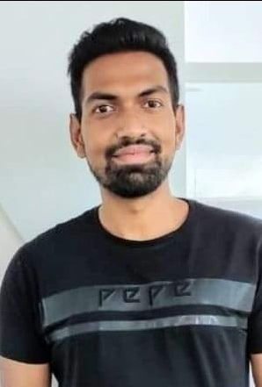
Know Your Trainer
My name is Saurabh Kandhway . I have around 10 years of Experience into QA Automation role . I am currently working as a Test Architect in one of the Leading MNCs .I have around 5+ years of teaching experience into all the tools and technologies used for testing .I have also worked as Onsite test analyst for 2 years in Melbourne Australia .I am ISTQB , AZ 900 Microsoft Azure Fundamentals, Pcloudy (Cloud based environment for Testing) certified testing professional . I am a certified Simplilearn high Engagement trainer.

Slide 3
Demand for Automation Tester in Current Market
All the Web Applications may it be JAVA based, .NET based , Peoplesoft or CRM need a Automation framework as it saves a lot of time .
Selenium Supports all the different types of Web Application and since it is a open source the market size for selenium is also huge as compare to others .
In this course you are also learning to create a CT pipeline from scratch which is a current market trend for all the organization.
An increase in demand for testing process automation and solutions that offer a smooth client experience is driving the market for testing automation

Slide 4

About the Course
In this course you will learn from scratch all concepts of Core Java , Maven,Selenium,TestNg , Cucumber .
You will be able to create a BDD Cucumber framework from scratch using Page Object Model .
Automate any Web Based Application
You will be able to easily crack the job interview and work in any of the organization with shear confidence and will be able to take up any challenges

Slide 5

Course Content
Core Java Concepts
Advance Java Concepts
Maven
Introduction to Selenium and Web Drivers
Automating Web Element Attributes and Deep diving into Selenium Concepts
Test Ng
Cucumber and BDD
GITHUB Concepts
CICD Implementation into Automation Framework

Slide 6

Pathways and Milestones
1. Assignments will be given on a timely basis and needs to submitted accordingly .
2. After every 15 classes there will be scheduled exams and adding to that there will be surprise 3 to 4 MCQ Exams
3. There will be whatsapp group where you can post your queries and resolution will be given accordingly .
4 . Whatever doubts will be there please keep a note of that and get you queries clarified by the end of session or course .
5. All the recorded videos will be shared within next 6 to 12 hours for your reference

Slide 7

By the End of this Course
You will be able to create a Industry Standard BDD Cucumber Framework with Page Object Model Design Pattern including the features of TestNg from Scratch
You will be able to do Parallel Testing , Cross Browser Testing and will also be able to debug the test failures
You will become master in Core Java Programming and will easily be able to write very complex java program .
You will get multiple job references from me and Gro Tech Minds team .

